Slide 1
Organizational Behavior
Module 13: Leadership
Notes:
Cover Image: "Untitled." Authored by: StartupStockPhotos. Provided by: Pixabay. Located at: https://pixabay.com/en/ideation-startup-entrepreneur-3267505/. Content Type: CC Licensed Content, Shared Previously. License: CC0: No Rights Reserved.
All text in these slides is taken from https://courses.lumenlearning.com/wmopen-organizationalbehavior/ where it is published under one or more open licenses.
All images in these slides are attributed in the notes of the slide on which they appear and licensed as indicated.

Slide 2
Module Learning Outcomes
Recognize good and poor leadership and the varieties of leadership
13.1: Describe the history of leadership as a topic inside organizational behavior
13.2: Discuss the pros and cons of leadership styles and topics
13.3: Describe the history, context and utility of the distinction between leadership and management

Slide 3
The History of Leadership Theories

Slide 4
Learning Outcomes: The History of Leadership Theories
13.1: Describe the history of leadership as a topic inside organizational behavior
13.1.1: Discuss our understanding of leadership from the historical perspective
13.1.2: Describe the early trait approach
13.1.3: Describe the behavioral approach
13.1.4: Describe the contingency approach and its variations

Slide 5

Leadership is…
a group phenomenon
using influence
goal directed
assumes hierarchy
Notes:
Untitled. Authored by: TukTukDesign. Provided by: Pixabay. Located at: https://pixabay.com/illustrations/icon-leader-leadership-lead-boss-1623888/. License: CC0: No Rights Reserved. License Terms: Pixabay License

Slide 6
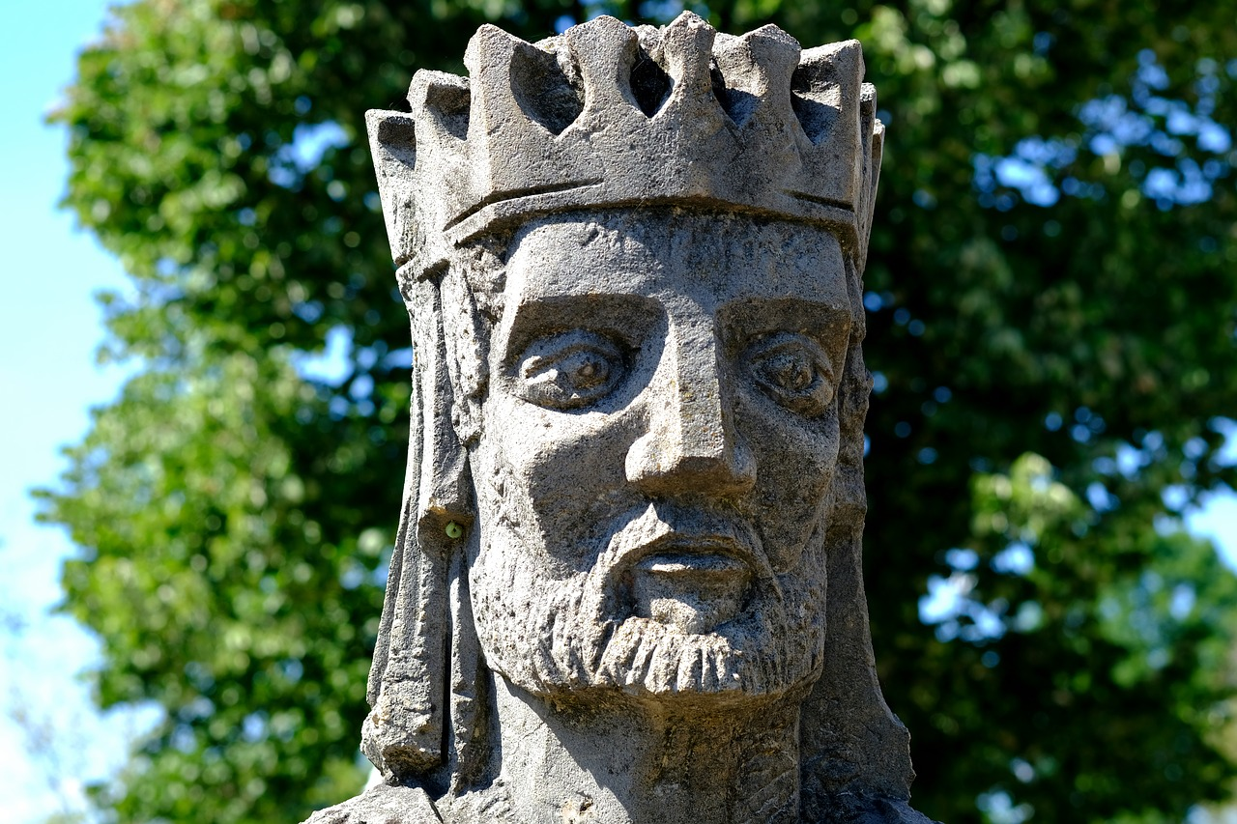
History of Leadership
Born, not made
Divinely chosen
Notes:
Untitled. Authored by: music4life. Provided by: Pixabay. Located at: https://pixabay.com/photos/king-face-figure-expression-head-2346347/. License: CC0: No Rights Reserved. License Terms: Pixabay License

Slide 7
Class Discussion: Your Favorite Leader (part 1)
Get into groups of three or four people, and discuss a favorite past leader. Yours could be a coach, a teacher, or a former manager. Each member of the group should pick his or her own leader.
The group should discuss personality traits that make a leader successful. Does your favorite leader have any of those personality traits?
Write down four or five qualities your favorite leader exhibited.
Notes:
The purpose of the exercise is to have students start to determine which personality traits make for a good leader. Then talk about the pros and cons of trait leadership theory as you cover the material. Do these traits really define a leader? Or could it be something more?
Can people exhibit those qualities and not be good leaders? The answer, after discussion, should be yes.
Ultimately, tell them to save their assessment of their favorite leader, because we’re going to revisit it as we broaden our knowledge of leadership theories.

Slide 8
Early Trait Theories
Galton’s “eminent men” and hereditary theories
Cowley’s “complex group of leadership traits”
Zaccaro’s “Individual differences can still predict leadership effectiveness”
Ultimately…
Traits can predict leadership.
Traits do a better job of predicting the emergence of leaders and the appearance of leadership than they do distinguishing between effective and ineffective leadership.

Slide 9
Class Discussion: Your Favorite Leader (part 2)
Now we understand that qualities alone do not make a leader effective. A person can possess leadership qualities and still not be an effective leader. So let’s take a look at behavior!
Get back together in your group and discuss how your favorite leaders behaved. Look at two things:
The leader’s behavior with people (e.g. motivating, caring about them, helping them be productive, etc.)
The leader’s behavior around accomplishing the goal
Write down these behaviors and prepare to discuss
Notes:
Review discussion should prepare the room for learning the behaviors theory

Slide 10
Behavioral Approach
The Ohio State Studies
The University of Michigan Studies
Blake’s and Mouton’s Managerial Grid
The Scandinavian Studies
Ultimately…
Behavioral theories had modest success in identifying consistent relationships between leadership behavior and group performance.
None of these consider situation as a factor.

Slide 11

Contingency Theories of Leadership
Contingency theory states that leadership is a combination of traits, behaviors and situations
Fiedler Contingency Model
Cognitive Resource Theory
Hersey and Blanchard’s Situational Theory
Leader-Member Exchange Theory
Path-Goal Theory
Leader Participation Model
Notes:
Untitled. Authored by: danymena88. Provided by: Pixabay. Located at: https://pixabay.com/photos/leader-leadership-manager-team-2206099/. License: CC0: No Rights Reserved. License Terms: Pixabay License

Slide 12
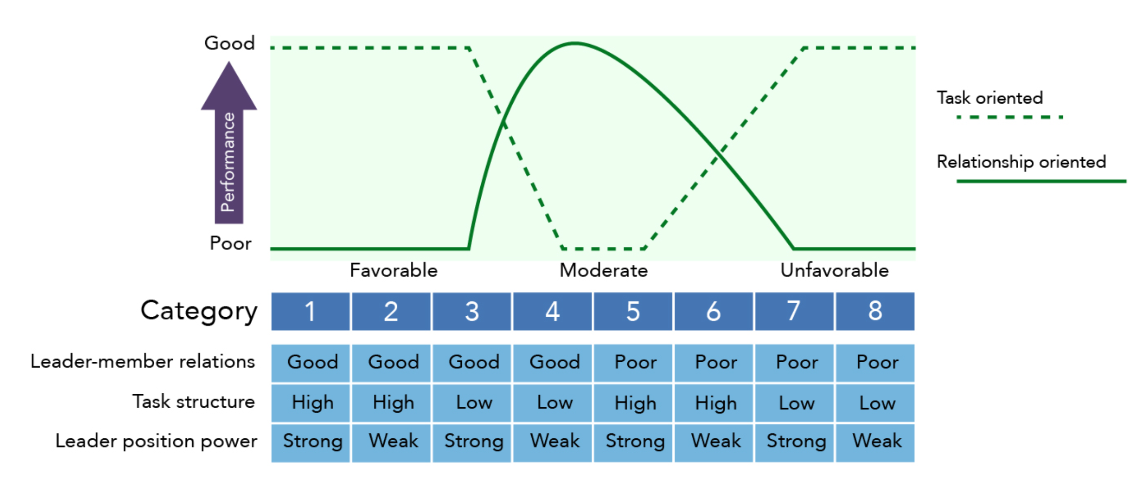
Fiedler’s Contingency Theory
Notes:
Image: Fiedler Model. Provided by: Lumen Learning. License: CC BY: Attribution

Slide 13
Class Discussion: Your Favorite Leader (part 3)
Now we’re starting to get a full picture of how a leader is effective.
We know that Fiedler’s Contingency Theory isn’t perfect, but let’s use it as a measuring tool for your favorite leader anyway!
Get back into groups and discuss your favorite leader, and how s/he might rank in terms of
Leader/member relations (good/poor)
Task structure (high/low)
Leader power orientation (strong/weak)
Discuss your ratings in your group and why you each chose those ratings for your favorite leader. Use examples from your experiences with your leader.
Decide where your favorite leader falls on Fiedler’s chart.
Notes:
Discuss the students’ thoughts and approach on rating their leaders. Discuss how each of these theories has some merit, and the truth really lies somewhat with all three. Discuss how these theories really work together

Slide 14
Practice Question 1
In the late 1920s, W.H. Cowley proposed that ________________.
that any study of leadership of value should produce a list of traits which go together to make a leader.
that eminent relatives “dropped” off in the second and third degree relatives, providing evidence that abilities are inherited.
that individual differences can predict leader effectiveness.
that leadership exists between persons in a social situation, and persons who are leaders in one situation may not be a leader in another
Notes:
Answer is A

Slide 15
Leadership Styles and Topics

Slide 16
Learning Outcomes: Leadership Styles and Topics
13.2: Discuss the pros and cons of leadership styles and topics
13.2.1: Identify leadership styles
13.2.2: Understanding trust as an element of successful leadership
13.2.3: Identify contemporary leadership roles
13.2.4: Discuss common issues leaders must face
13.2.5: Identify challenges to the concept of leadership

Slide 17

Kurt Lewin and Leadership Traits
Developed three distinct leadership styles after observing children completing a craft project:
Authoritarian (autocratic)
Participative (democratic)
Delegative (laissez-faire)
Notes:
Untitled. Authored by: Pixabay. Provided by: Pexels. Located at: https://www.pexels.com/photo/girls-on-desk-looking-at-notebook-159823/. License: CC0: No Rights Reserved.

Slide 18

Other leadership styles
Transactional
Charismatic
Transformational
Servant
Notes:
Pawns. Authored by: Markus Spiske. Provided by: Unsplash. Located at: https://unsplash.com/photos/QozzJpFZ2lg. License: CC0: No Rights Reserved. License Terms: Unsplash License

Slide 19
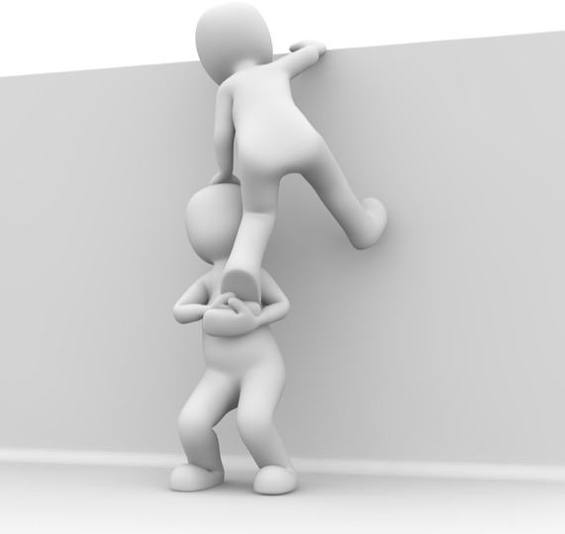
Trust in leadership
Deterrence-based
Knowledge-based
Identification-base
Notes:
Image: Untitled. Authored by: 3dman_eu. Provided by: Pixabay. Located at: https://pixabay.com/illustrations/friends-trust-friendship-together-1015312/. License: CC0: No Rights Reserved. License Terms: Pixabay License

Slide 20

Leadership Roles
Providing team leadership
Mentoring
Notes:
Mentor Startup. Authored by: Tumisu. Provided by: Pixabay. Located at: https://pixabay.com/illustrations/mentor-startup-mentorship-advice-2062999/. License: CC0: No Rights Reserved. License Terms: Pixabay License

Slide 21


Leadership Issues
Technology and changing roles
Industry disruption
Distributed workforces
Notes:
Webinar Conferencing . Authored by: mohamed Hassan. Provided by: Pixabay. Located at: https://pixabay.com/illustrations/webinar-conferencing-video-beverage-3199164/. License: CC0: No Rights Reserved. License Terms: Pixabay License

Slide 22

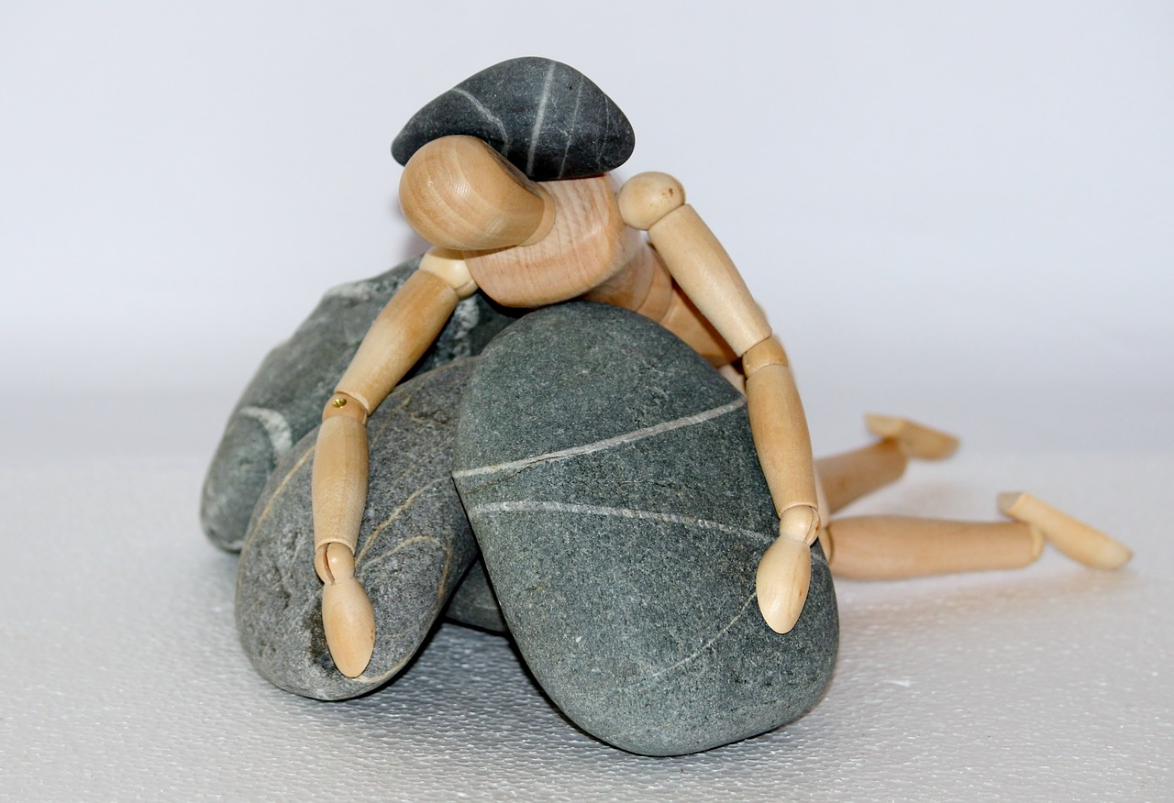
Challenges to leadership
Leadership Attribution Bias
Substitutions and Neutralizers
Notes:
Untitled. Authored by: rawpixel. Provided by: Pexels. Located at: https://www.pexels.com/photo/man-wearing-blue-suit-jacket-beside-woman-with-gray-suit-jacket-1059118/. License: CC0: No Rights Reserved.
Holzfigur stones. Authored by: Counselling. Provided by: Pixabay. Located at: https://pixabay.com/photos/holzfigur-stones-life-struggle-980784/. License: CC0: No Rights Reserved. License Terms: Pixabay License

Slide 23

Practice Question 2
Which leadership style is characterized by a set of activities that involve exchanges between leaders and followers concerning daily tasks?
Charismatic
Delegative
Transactional
Servant
Notes:
Answer is C
Checklist. Authored by: Tero Vesalainen. Provided by: Pixabay. Located at: https://pixabay.com/photos/checklist-check-list-marker-2077020/. License: CC0: No Rights Reserved. License Terms: Pixabay License

Slide 24
Practice Question 3
What is a characteristic of identity-based trust?
The potentially harmed party must be willing to introduce harm in return if trust is violated
An individual can predict behavior based on past interaction.
The trust is based on an emotional connection between the two parties
Trust is masked by the growth of the company
Notes:
Answer is B

Slide 25
Leadership vs Management

Slide 26
Learning Outcomes: Leadership vs Management
13.3: Describe the history, context and utility of the distinction between leadership and management
13.3.1: Analyze the difference between leaders and managers
13.3.2: Discuss the hybrid role of leader-managers in contemporary organizations

Slide 27

Leader vs Manager: Abraham Zaleznik
Leader
Inspiration
Vision
Human passion
Manager
Order
Control
Rapid solutions

Slide 28
Leader vs Manager: John Kotter
Leader
Inspiration
Vision
Human passion
Leader/Manager
Leadership focused on change
Management focused on complexity
Not necessarily two separate people
Manager
Order
Control
Rapid solutions

Slide 29
Roles of leaders and managers
Create momentum around your vision and the company’s vision
Set examples and explain your reasoning to earn employee respect
Accomplish goals
Innovate new solutions

Slide 30
Practice Question 4
Establishing a vision for teams, encouraging leaders of sub-departments, and innovating changes are all the duties of:
the leader of the company
the manager of the department
the leader/manager hybrid
all the employees of the company
Notes:
Answer is C

Slide 31
Quick Review
Many theories of leadership have developed over the years
Trait theories
Behavioral theories
Contingency theories
…but probably not divinely chosen!
Every leader has a style, whether it’s charismatic or authoritarian
Trust is intrinsic in leadership
Leaders must overcome obstacles like adjusting to new technology or managing dispersed workforces
There are some schools of thought that suggest leaders aren’t needed
There is a difference between a leader and manager, and today’s business climate tends to demand a leader/manager hybrid.

